Slide 1
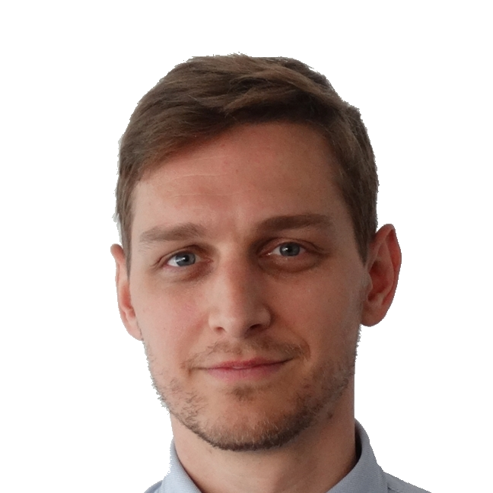
Track your rides
🚲
Notes:
Cycling data analysis with MATLAB Online and Mobile

Slide 2
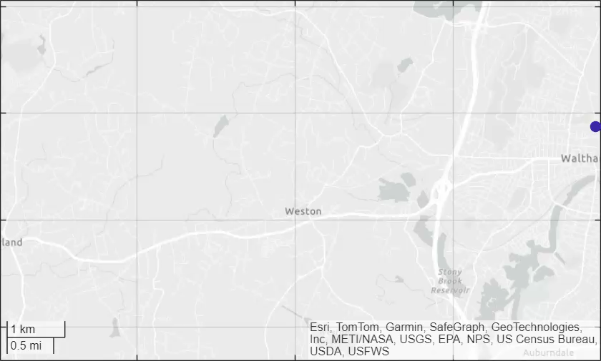
Track your rides
🚲

Slide 3
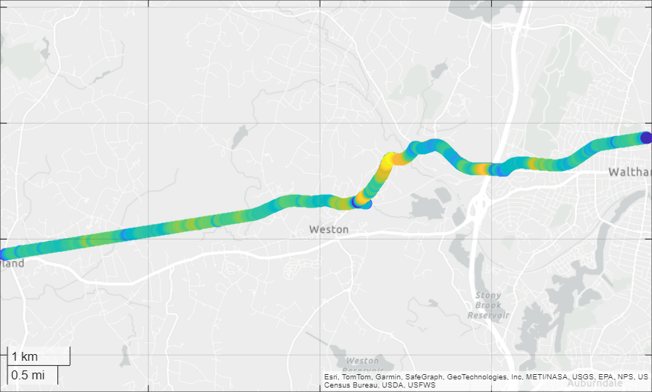
01:08:07 6.2 m/s
🚲

Slide 4
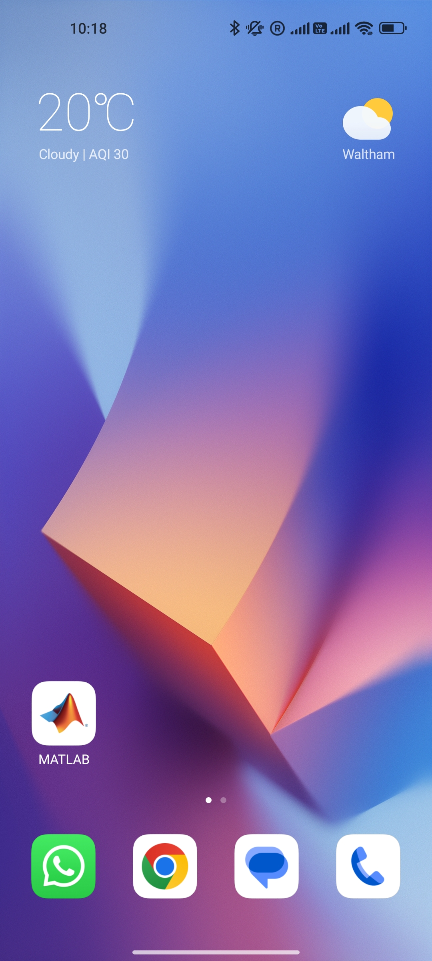

Slide 6
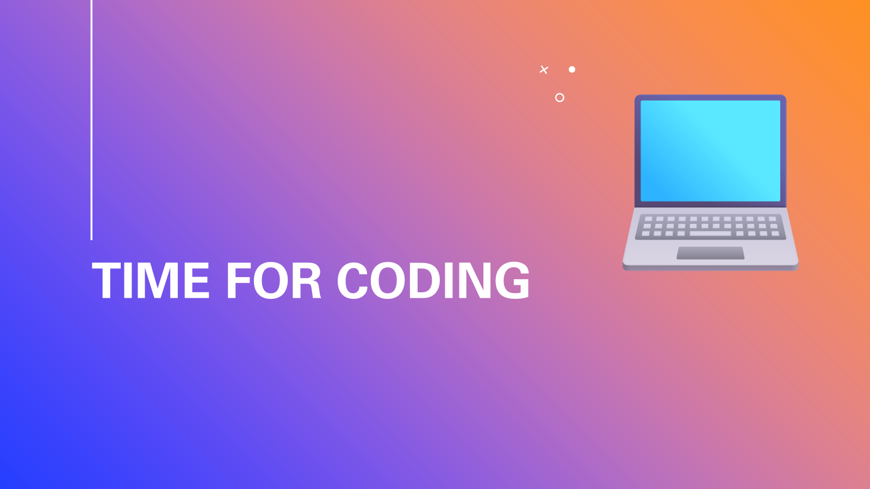
Time for coding
💻

Slide 7
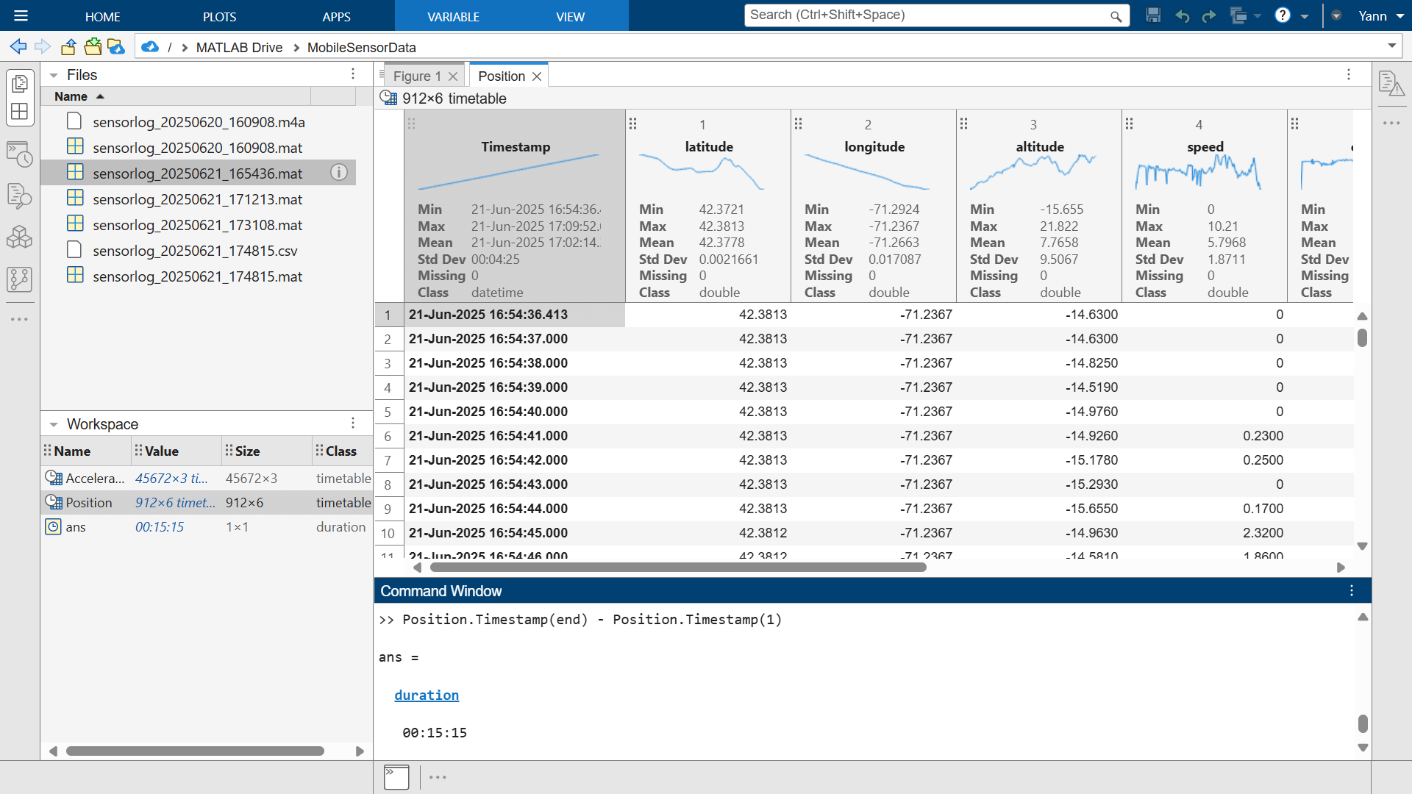

Slide 8
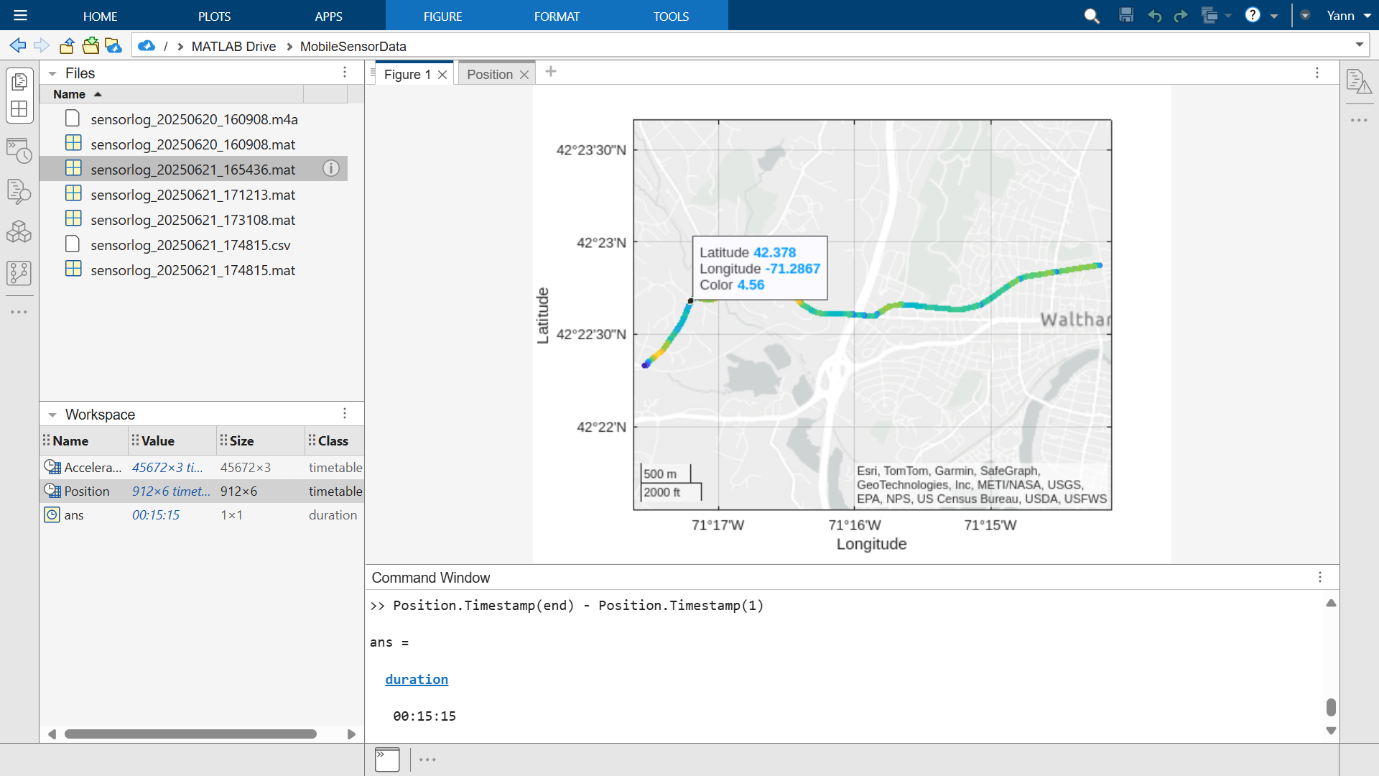

Slide 9
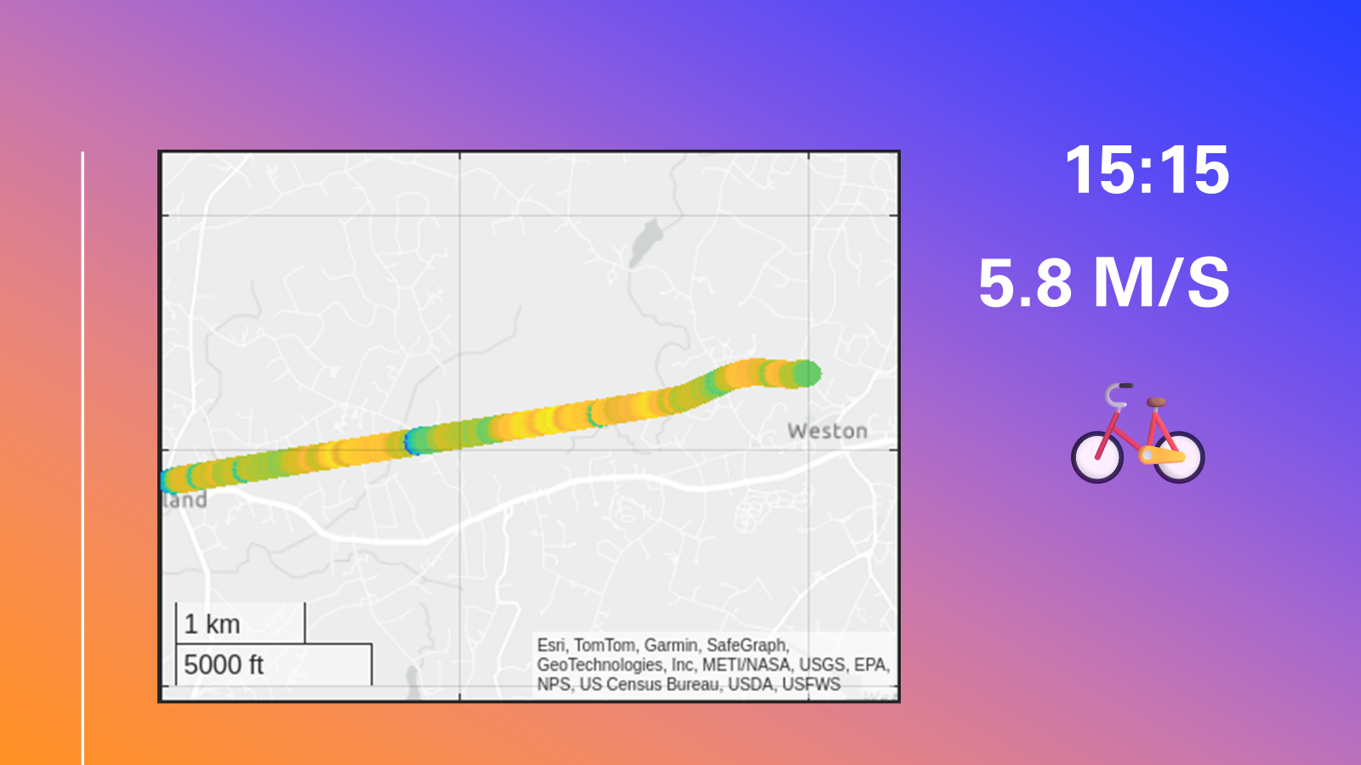
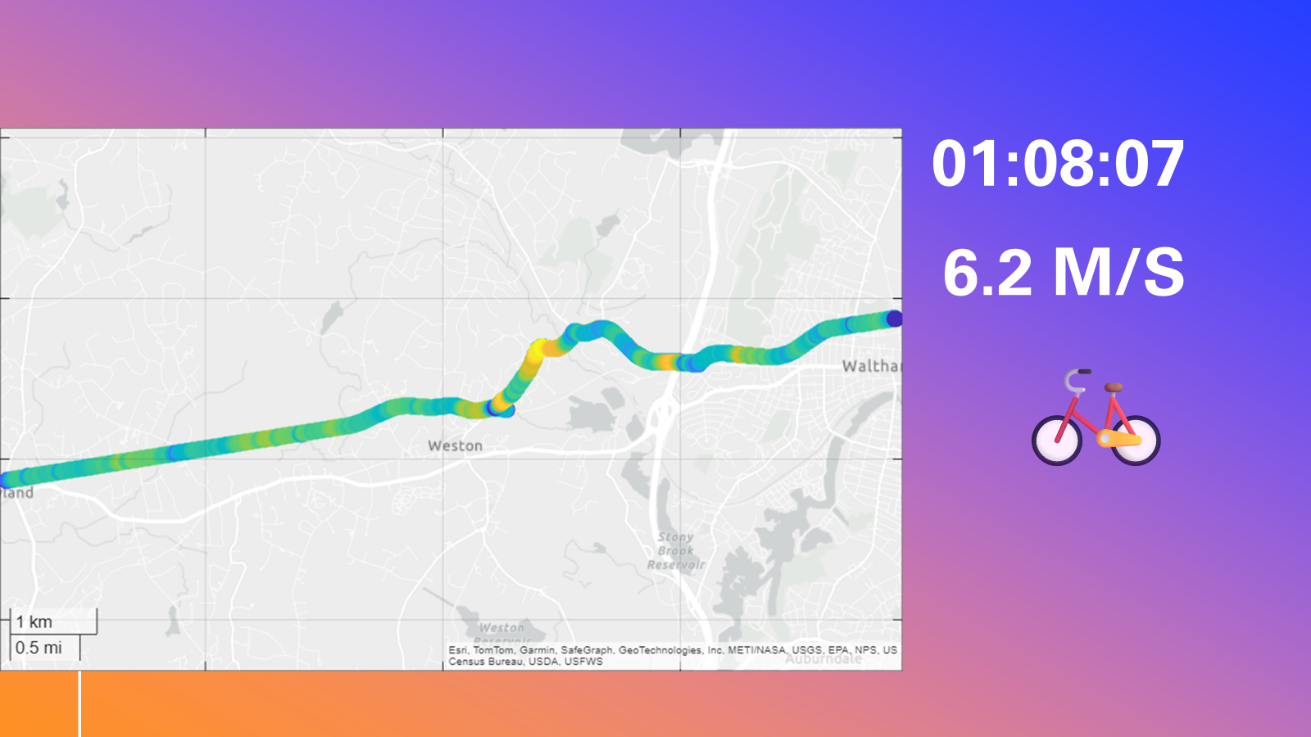
Share your Ride 🚴 or Run 🏃‍♂️

Slide 10


Slide 11
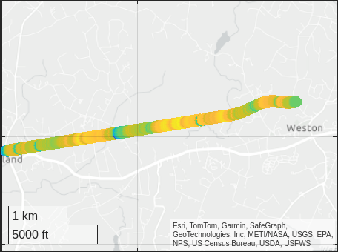
15:15 5.8 m/s
🚲

Slide 12
01:08:07 6.2 m/s
🚲

